Slide 1
The New World of Open Source Networking, Edge & IOT
Arpit Joshipura,
GM Networking, Edge, IOT
June 2019
Notes:
The new world has 3 characteristics
Telecom Networks will be built on Open Source through global collaboration and harmonization
Edge will be unified across Telecom, Cloud, IOT and Enterprise
Interdependency of Networking & Edge on Technologies like Cloud-native, AI, Blockchain – forcing vertical industries to collaborate

Slide 2
OPEN SOURCE NETWORKING IN TELECOM De-facto path with Global Collaboration and Harmonization

Slide 3

How We Got Here: 4th Step of Open Networking
Debunked
The LF is Changing the Fabric of Networking
“…bringing top networking vendors, operators, service providers, and users together.”
Open Collaboration
CLOUD NATIVE
Open Source
AUTOMATION
CONTAINERIZATION
Open Choice
DISAGGREGATION
ORCHESTRATION
VIRTUALIZATION
SOFTWARE DEFINED NETWORKING
NETWORK FUNCTIONS VIRTUALIZATION
Notes:
Journey started a few years ago with SDN & NFV. 2018 was the year of Open Source automation and this year is the year of collaboration ! (technologies, industries)

Slide 4






































Open Source Networking Collaboration 9/10 Top Open Source Projects + Operators representing 70% of Mobile Subs + Top 10/10 Vendors & SI
Projects
Carriers
Vendors
& SI
Notes:
Linux Foundation is honored to host 9/10, enable participation from 70-% and best of all, leaving NO networking vendor behind!

Slide 5









End users have moved to Open Source deployments
“ONAP is a key element in Reliance Jio’s MANO ecosystem. Our transformation towards a Machine Learning-driven cognitive network continues to accelerate as we embrace the evolution towards 5G.”
“…Bell Canada has been aggressive in terms of virtualizing its network assets. The carrier late last year was the first organization to deploy an open source version of ONAP in a production environment”
“AT&T and Ericsson demonstrate world’s first network slice with lifecycle management based on ONAP.”
LightReading: Orange plans 5G + Automation RFP “Requires Open Source/ONAP”
Vodafone, China Mobile Tap ONAP for Broader Network Orchestration
SDxCentral: “AT&T, Nokia Tighten 5G Focus on O-RAN, Akraino”
Notes:
This collaboration and creation led to major deployments as operators automate networks prior to 5G globally

Slide 6
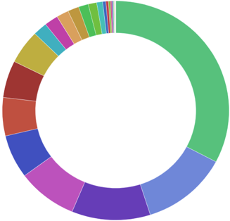
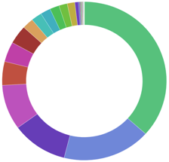
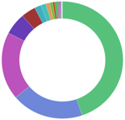
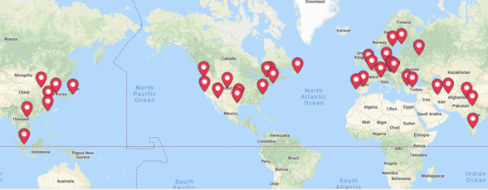
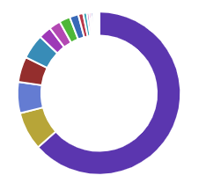
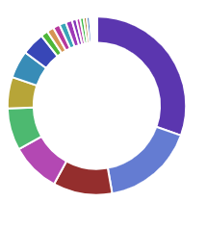

Global impact of Open Networking Diversity across People, Geography & Company– True Marks of Open Source Software
LFN Technical Leadership Panel ONS EU 2018
2018: 18 Meetups, 733 Attendees
38 groups, 24 countries, 8K+ members
ONAP Participation Diversity
OSN Days: 4 Tours, 13 Events, 1400+ Attendees
India: Mumbai, Bangalore, Pune, Delhi
China: Shanghai, Nanjing, Beijing
APAC: Singapore, Taiwan, Tokyo
NorAm: Ottawa, Bay Area, Dallas
OpenDaylight – Six Years of Diversity
Notes:
It is not just what you do that defines OSS but how it gets done….

Slide 7
Global Collaboration & Harmonization OVP: Global Collaboration for Compliance & Verification LFN: Standards implementation in Open Source Software

Slide 8


OVP: Compliance & Verification Program Accelerating Deployment – Reduce Operator & Supplier Integration/Interop Testing Intervals By 50%
Operator Services on Boarding
Operator Services on Boarding
VNF SDK and VVP
VNF
VNF
VNF
VNF
VNF
VNF
VNF
VNF
NFVO
NFVO
NFVO
NFVO
NFVO
VIM
VIM
VIM
VIM
VIM
VIM
NFVI
NFVI
NFVI
NFVI
NFVI - Aligned
Notes:
From:
Too many separate solutions for VNF and NFVi lifecycle management and onboarding
To:
Simplified & VNF on-boarding, Reduced time and cost of operationalizing a VNF through a common NFV Framework*

Slide 9


Standards & Open Source Software – The NEW Normal
Most Downloaded Open Source Networking Whitepaper REFRESHED!
New Whitepaper

Slide 10









Showcase For Standards and Open Source Collaboration
Debunked
&
Notes:
But wait, there is one more thing….

Slide 11
The UNIFIED EDGE Unifying IOT, Telecom, Enterprise, Cloud Edges
Notes:
Next need is unifying the edge OSS

Slide 12

Cloud + IOT + Enterprise + Telecom
News
Unified Community for Edge Computing across Cloud, IOT, Telecom and Enterprise
Builds on EdgeX Foundry & Akraino with 5 founding projects & 60 founding members
Harmonization with SDO, Consortiums (ETSI, IIC, AECC…) at launch
Major Support from China
LF Edge Builds Momentum with Growing List of New Members, Blueprints as Community Works Towards Interoperability for Open Edge Computing
New Open Edge Demos from Akraino and Project EVE to Debut at Open Networking Summit North America
OPEN NETWORKING SUMMIT, SAN JOSE, Calif., April 2, 2019 – LF Edge, an umbrella organization within the Linux Foundation that aims to establish an open, interoperable framework for edge computing independent of hardware, silicon, cloud, or operating system, today announced growing momentum with new blueprints from Akraino Edge Stack and four new General members

Slide 13




















Bringing It All Together – LF Edge, Access & Core Cloud, IOT, Enterprise and Telco Edge
Standards & Orgs for Edge
Mobile
Carrier Cloud
Data Center
Carrier
Access
Carrier
Interconnect
Residential
Internet /
Web
IoT Alliances & Consortiums
Hosted Private Cloud
Public Cloud
SMB/ROBO
Enterprise
& IIOT
Enterprise
Open Access
Open Edge
Core & Cloud
Other Edge Activities

Slide 14
TECHNOLOGIES & INDUSTRY INTERDEPENDENCE + COLLABORATION Cloud Native (Kubernetes) & LFN Blockchain (Hyperledger) & LFN LFN & LF AI

Slide 15
A new hybrid world of Virtual Machines and Containers
LF Networking jointly collaborating with OpenStack for NFVI & VNF ecosystem and with CNCF/Kubernetes to enable Cloud native Network Functions (CNF)
+
Efficiency + Portability + Simplicity

Slide 16

Blockchain + Telecom: Announced at MWC 2019
LF Networking and Hyperledger collaborating for next gen use cases
Cybersecurity & Fraud Prevention
5G Implementation
Smart Contracts
Cyber security
Big Data Monetization
Smart Cities and IoT

Slide 17


LFN ONAP enabling the Edge, Cloud Native, O-RAN & AI
Services
Cloud Services
Residential Services
Enterprise Services
IOT/Edge/AI Services
Software &
Automation
Cloud Automation
Telecom Network Automation
Edge Automation
Enterprise Software Defined Data Centers (SDDC)
Data Centers
Carrier Network
Cloud Network
Public/Hybrid
Cloud Service Providers
Cloud Hosting
Private Cloud Providers
Web Service Providers
Infrastructure
Service Providers

Slide 18
Takeaways: The Year of Open Source & Collaboration
OPEN SOURCE NETWORKING IN TELECOM
De-facto path with Global Collaboration and Harmonization
The UNIFIED EDGE
Unifying IOT, Telecom, Enterprise, Cloud Edges
Telecom, Cloud, Enterprise - automotive, energy, insurance, banking, payments, supply chain + Networking/5G, AI, SDN/NFV, embedded, Blockchain, Cloud native
TECHNOLOGIES & INDUSTRY INTERDEPENDENCE/COLLABORATION
Cloud Native (Kubernetes) Blockchain (Hyperledger) & LF AI
Vertical Specific Solutions in Open Source

